Slide 1
Reproducing a computational Retrospective Study using MIMIC III
Suraj Joshi
HS-698 -Summer
MSHI
UNIVERSITY OF SAN FRANCISCO

Slide 2
Objective:
Recreating the Japanese Association for Acute Medicine (JAAM) ’s Disseminated Intravascular Coagulation scoring criteria.
Hypothesis:
If DIC is present in Day-1 of Severe Sepsis, mortality within 28 days of admission is higher.

Slide 3
Three Studies
Main Study of reference done in Japan.
Clinical Study
Gando S et al
PMID : 23787004
Our Study of reference done in NIH with MIMIC II data.
Java and SQL
Fabrício S. P. Kury
Vojtech Huser
James J. Cimino
This study is trying to reproduce the MIMIC II study using MIMIC III
Python and SQL
PMID : 26958216

Slide 4
Tools
MIMIC III database
Python
R
Pandas
Psycopg2
Postgres SQL
Virtual Machine – Vagrant

Slide 5
MIMIC III
Medical Information Mart
for
Intensive Care
Demographics, Vitals(T, BP, HR, RR qH), lab results(PT, Platelets, FDP, D-Dimer, WBC), procedures, medications, notes, image reports, mortality data ( 28 tables)
Request access→ Fill form→Take test→Get access

Slide 6
Have Access : What next?
Two ways
3GB RAM and 100 GB optimal
Postgres db →SQL → psycopg2 →Python
Follow the tutorial at : http://mimic.physionet.org/tutorials/install-mimic-locally-ubuntu/ 9 steps | Goto : https://github.com/nsh87/mimic-iii-vm 1 step mkvirtualenv mimic-iii-vm -a `pwd` -r requirements.txt

Slide 7
Background
Table Color Code
labevents | chartevents
Disseminated
Intravascular
Coagulation
Prothrombin time –INR
Platelets
Fibrin Degradation
Product FDP
Whie Blood Cells (WBC)
Heart Rate
Severe
Sepsis (SIRS)
Temperature (Celcius)
Respiratory Rate

Slide 8
Background contd...
Information from other Tables
admissions | Admission Date Discharge Date Date of death
diagnoses_icd | patient and admission specific diagnosis
d_items | list of all tests and item numbers eg. Temp, HR, RR
d_labitems | list of all lab test and item numbers eg. WBC, Platelet Counts, FDP, PT-INR

Slide 9
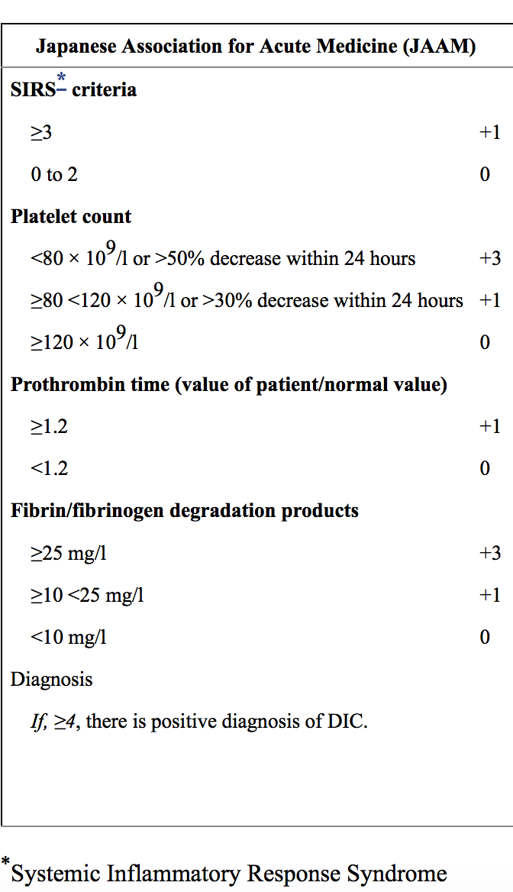

Slide 10
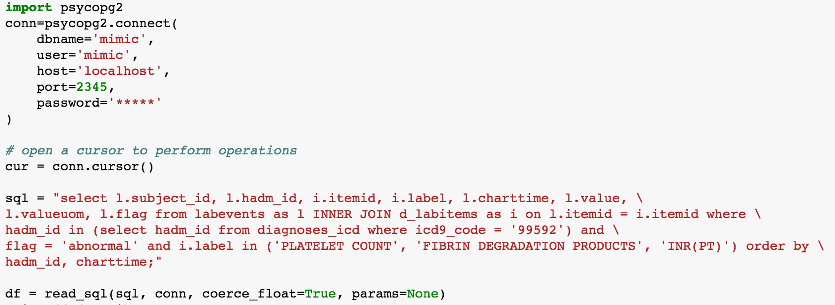
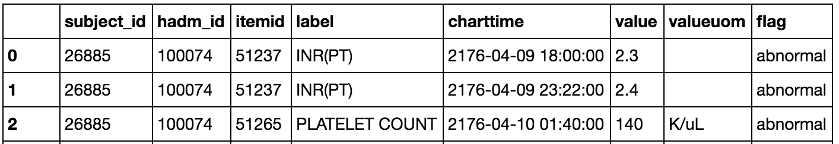
Set up a base data frame
Do all the group by’s in Database using SQL rather than Pandas

Slide 11
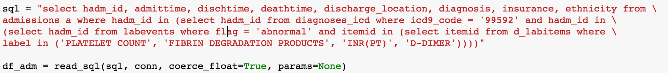
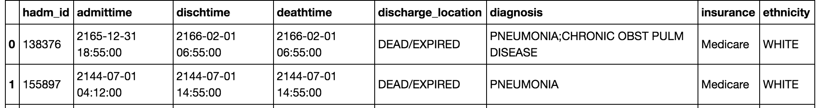
Extracting only patients diagnosed as severe sepsis from diagnoses_icd table.
Total 3625 patients
2nd Table - info on admissions, discharge and death

Slide 12
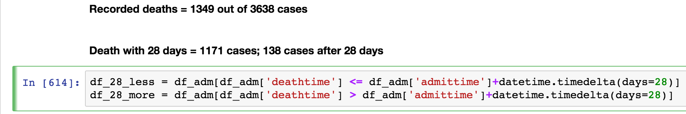
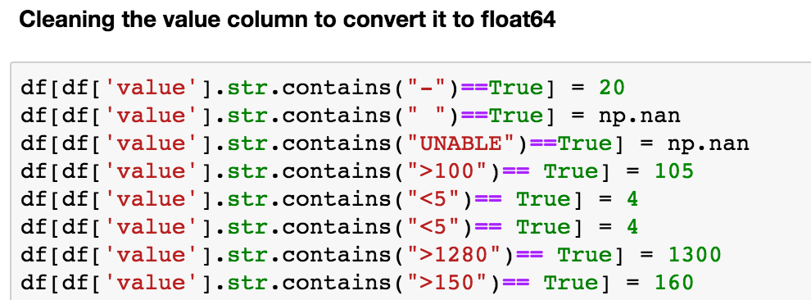
Extract patients who died within 28 days and those after 28 days.

Slide 13
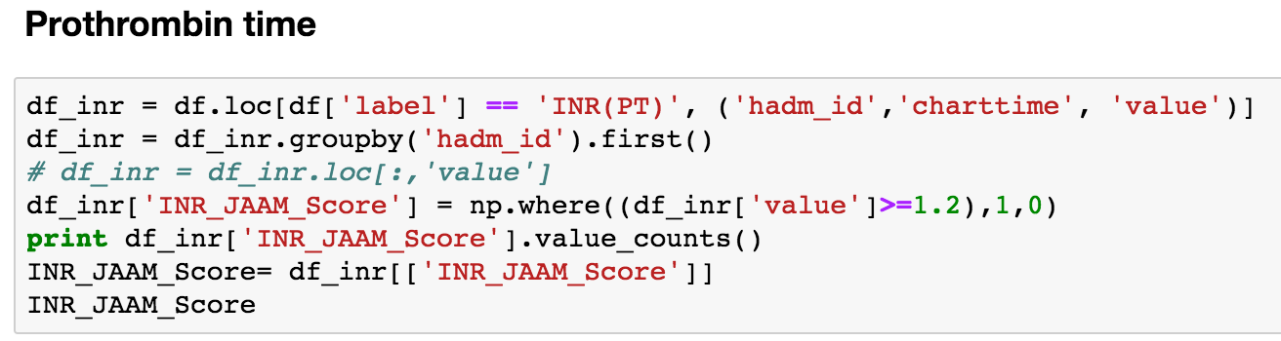
Building scores for PT-INR, Platelet count and FDP individually
PT-INR

Slide 14
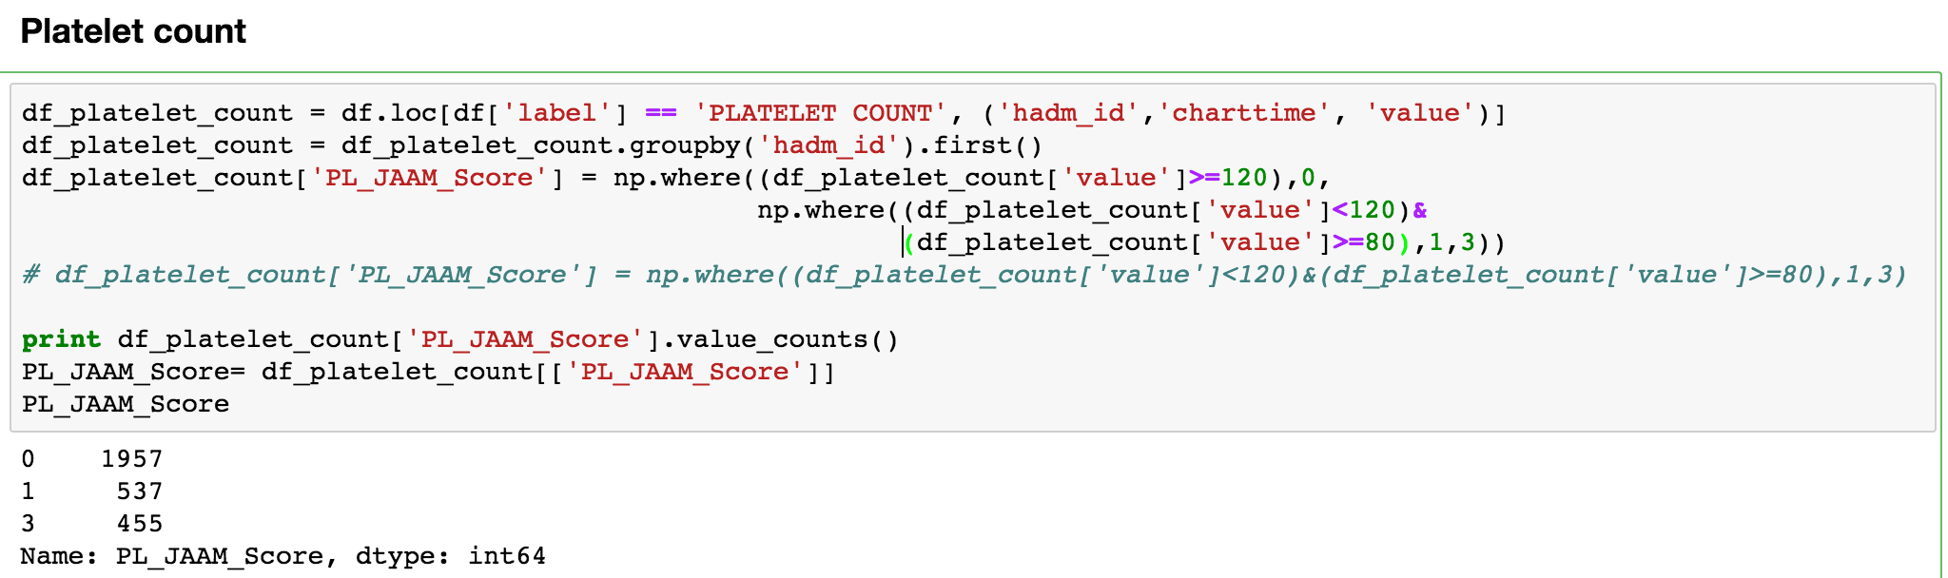
Building scores for PT-INR, Platelet count and FDP individually
Platelet count

Slide 15
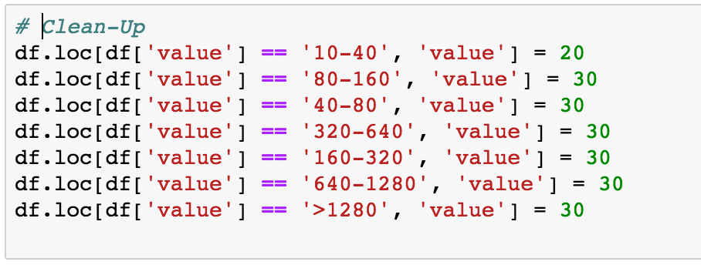
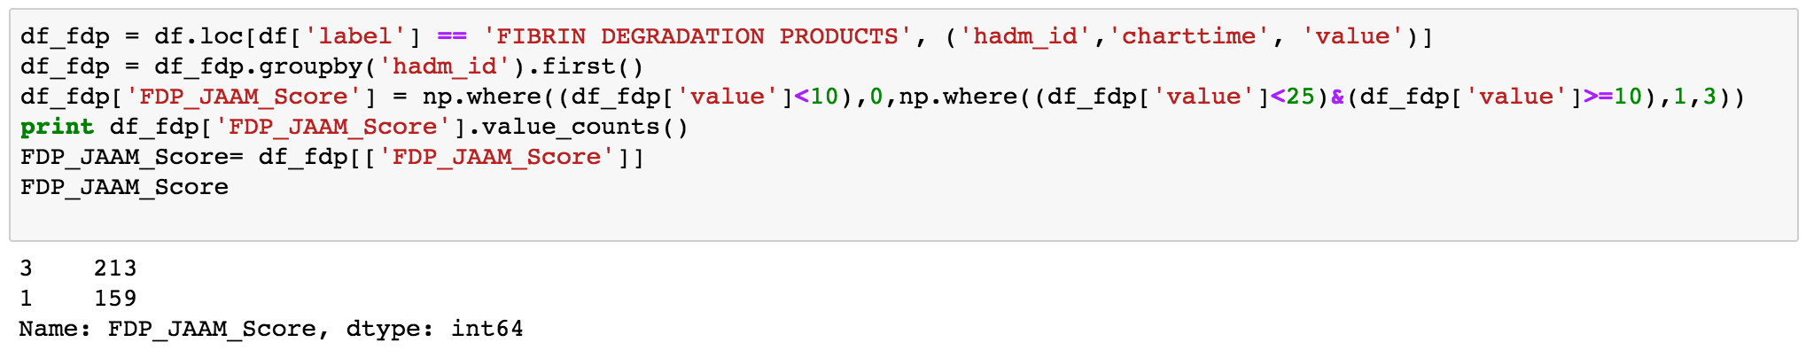
Building scores for PT-INR, Platelet count and FDP individually
Fibrin Degradation Products

Slide 16
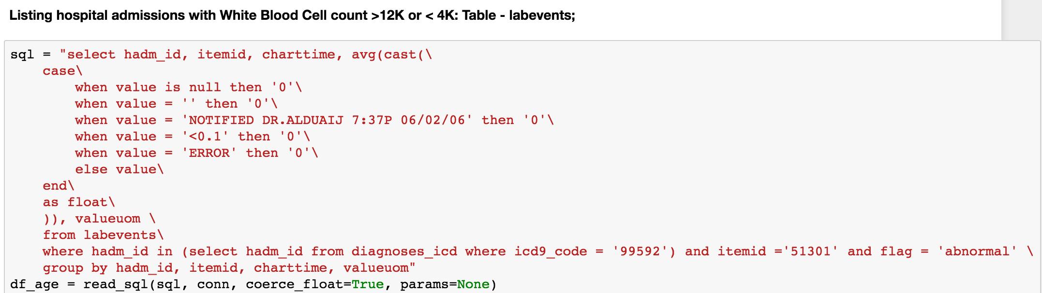
Building scores for SIRS WBC, Heart Rate (HR), Respiratory rate(RR) and Temperature (T) individually

Slide 17
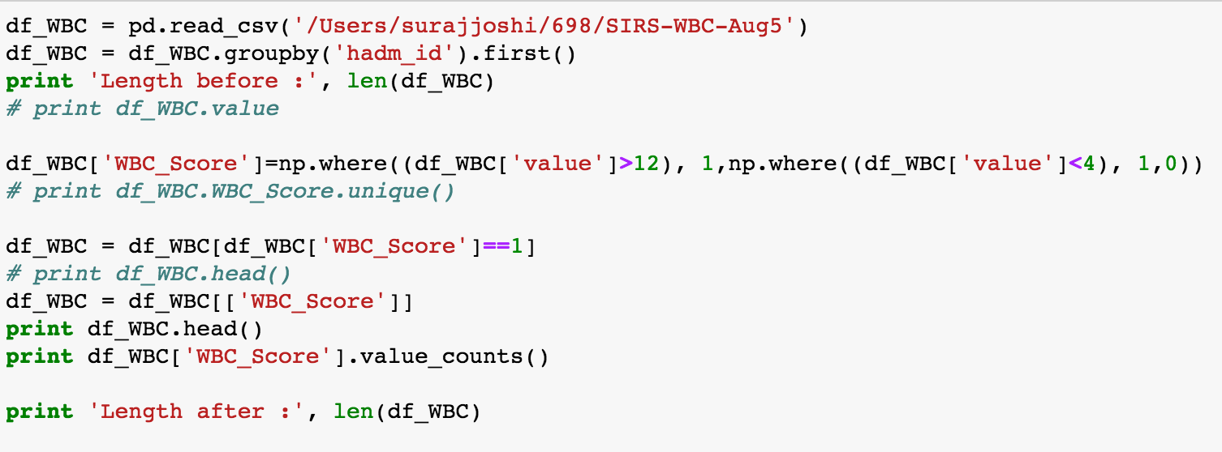
Building scores for SIRS WBC, Heart Rate (HR), Respiratory rate(RR) and Temperature (T) individually
White Blood Cells

Slide 18
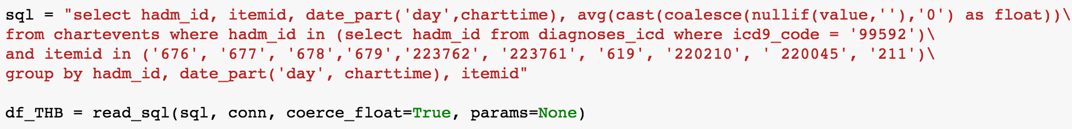
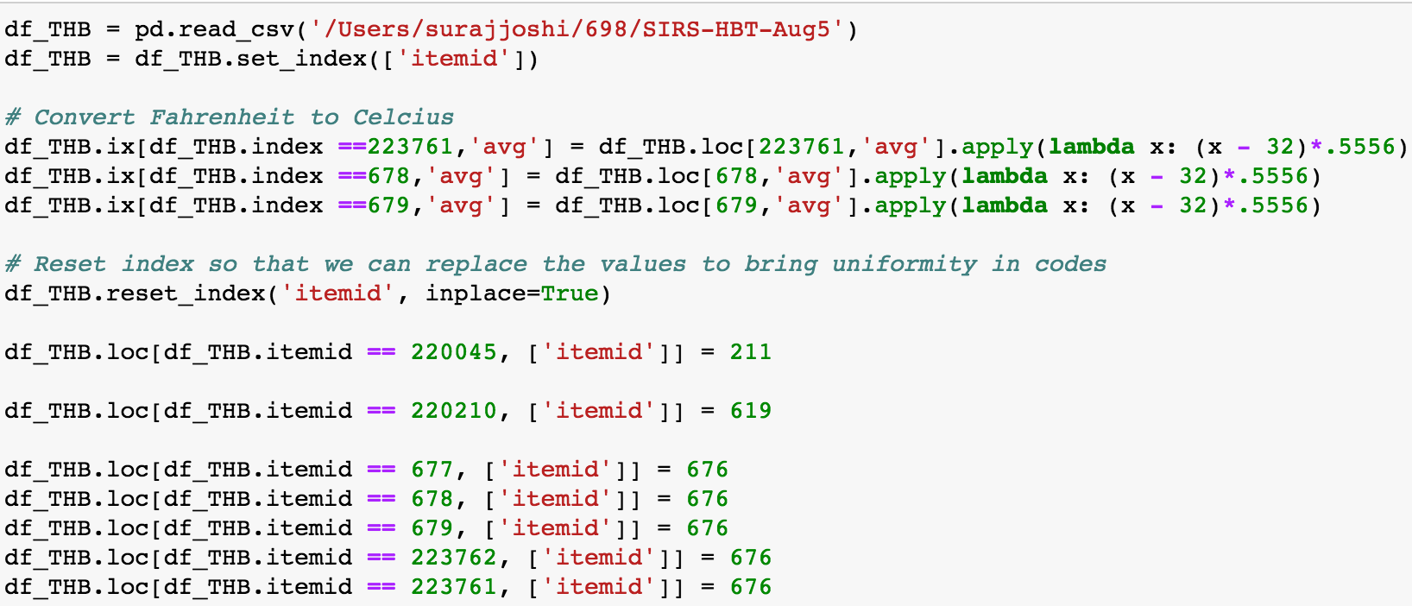
Building scores for SIRS WBC, Heart Rate (HR), Respiratory rate(RR) and Temperature (T) individually
White Blood Cells

Slide 19
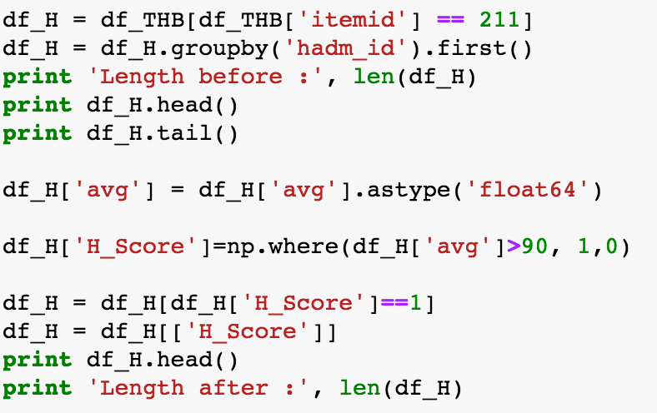
Building scores for SIRS WBC, Heart Rate (HR), Respiratory rate(RR) and Temperature (T) individually
Heart rate

Slide 20
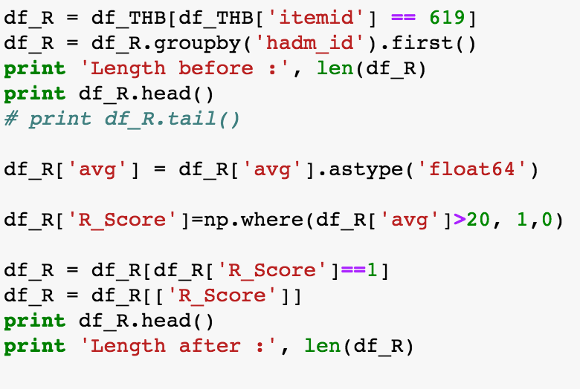
Building scores for SIRS WBC, Heart Rate (HR), Respiratory rate(RR) and Temperature (T) individually
Respiratory Rate

Slide 21
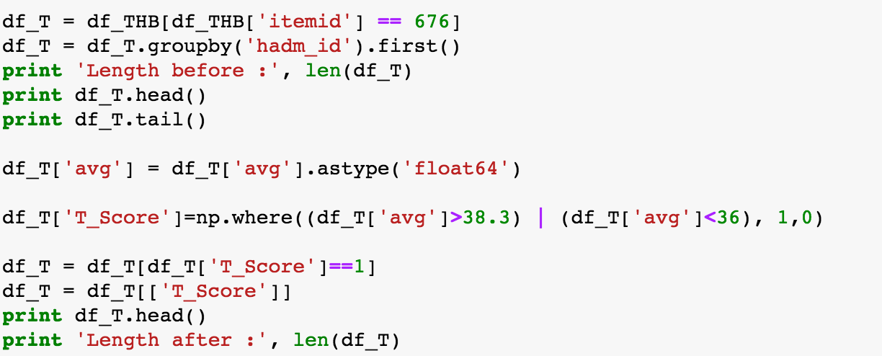
Building scores for SIRS WBC, Heart Rate (HR), Respiratory rate(RR) and Temperature (T) individually
Temperature

Slide 22
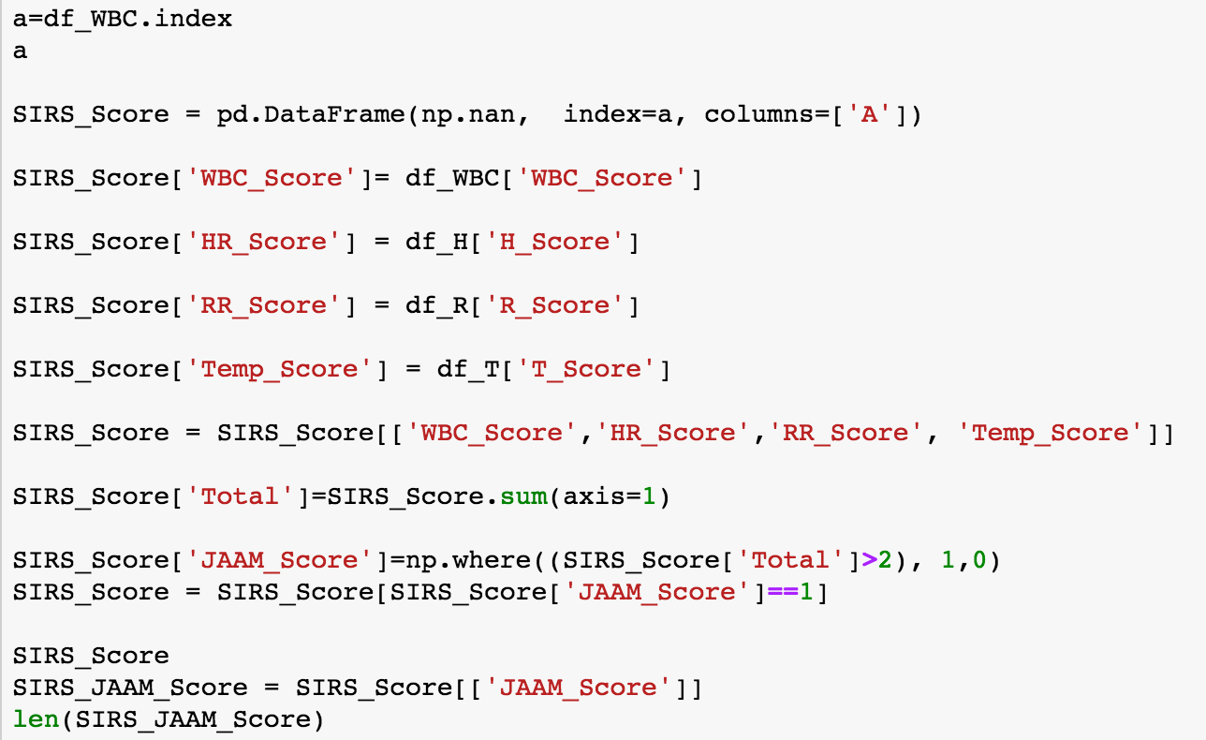
Totalling SIRS Score

Slide 23
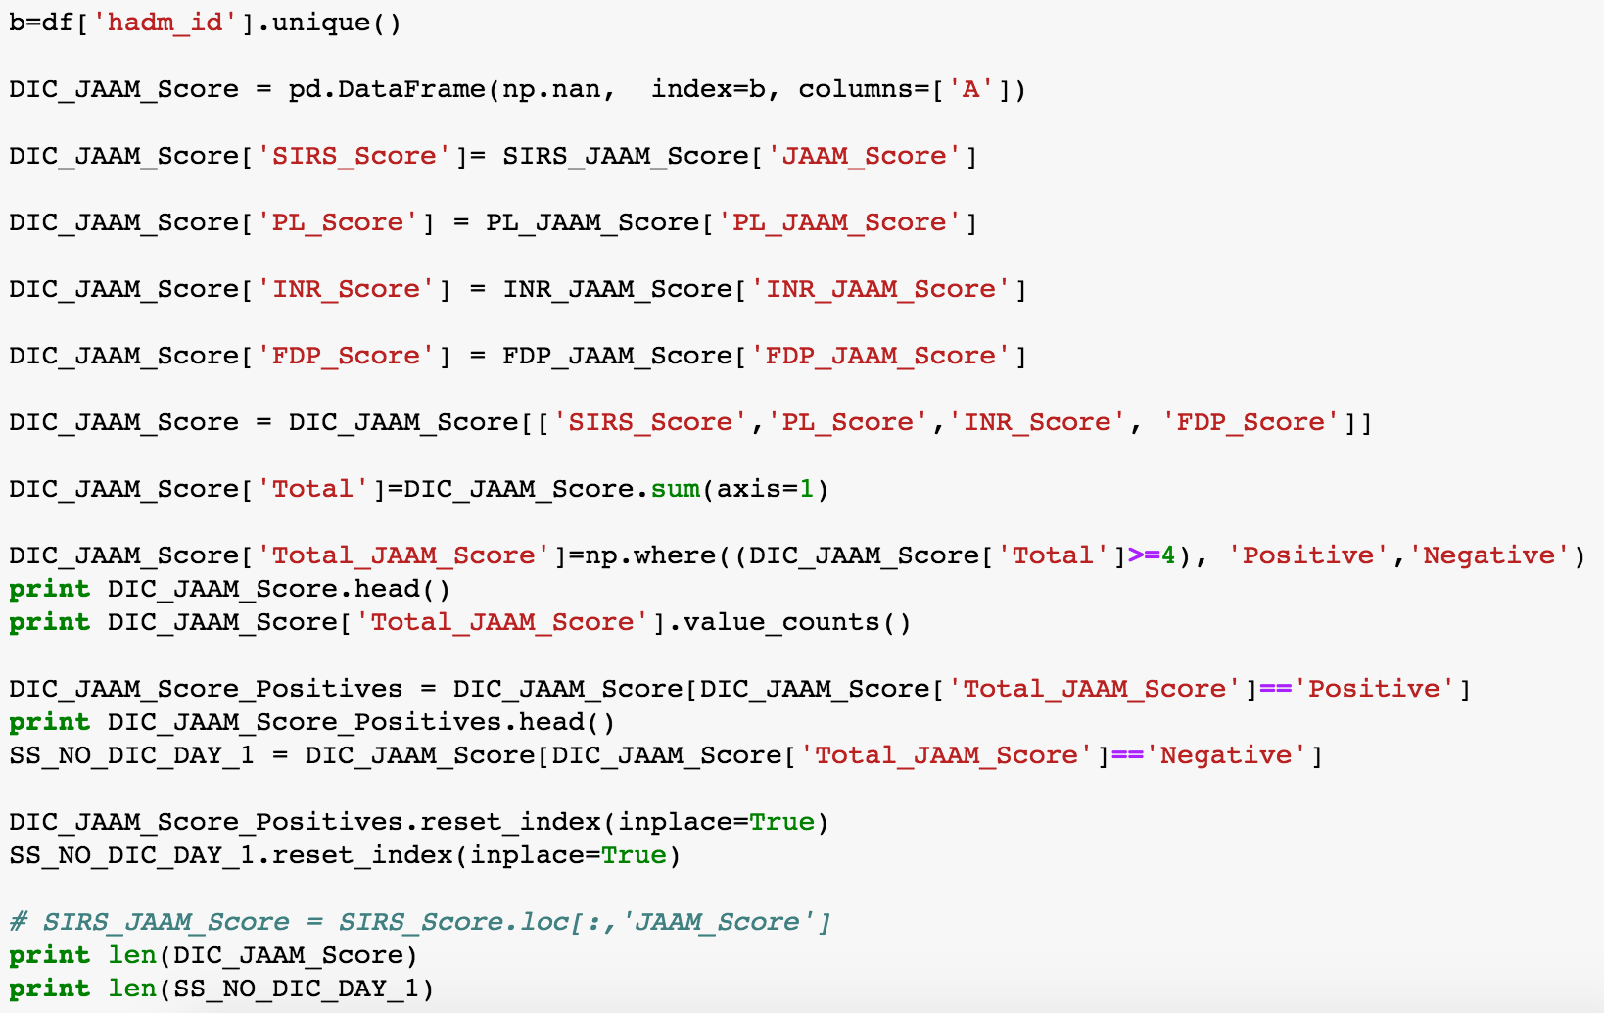
Stiching everything together.....

Slide 24
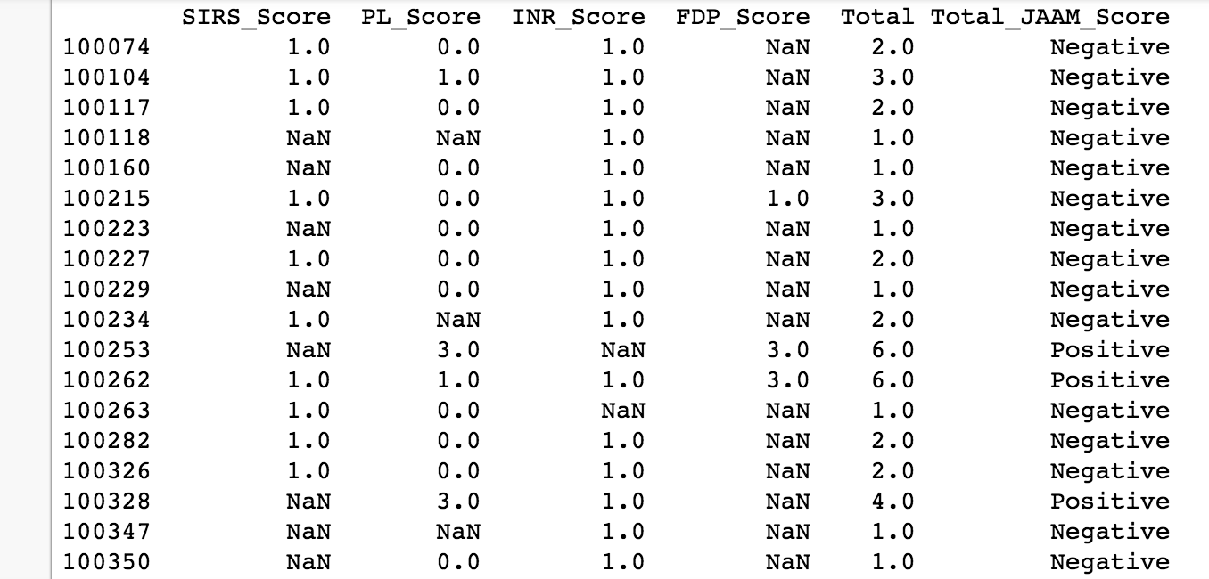
Final Table

Slide 25
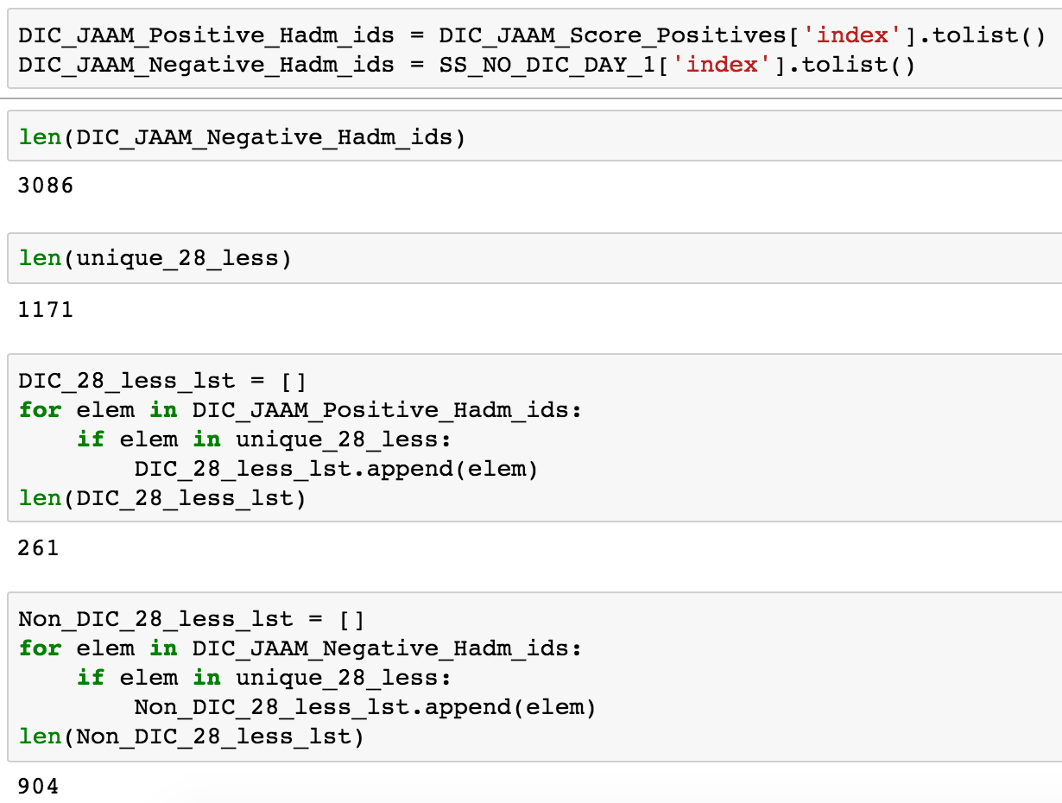
Numbers:

Slide 26
Results:
Description | Total Cases | Death within 28 days | Percentage | MIMIC II Study 2257 cases | Clinical Study 624 cases
Severe Sepsis Cases considered | 3625 | 1165 | 32%
DIC positive Day 1 | 539 | 261 | 48.42% | 44% | 31.2%
DIC negative Day 1 | 3086 | 904 | 29.29% | 27.5%

Slide 27
Thank you
esp. Prof. Nikhil Haas, MSHI Department and colleagues

